Slide 1
functional paradigm, delegates and LInq
Continuous staff improvement project
Rami Atieyeh

Slide 2
Introduction
What is functional paradigm
Functional vs imperative
Delegates
Anonymous functions
Lambda expressions
Extension methods
Linq
Fluent linq vs query linq
Linq operators examples: where – select
Anonymous types
Deferred execution

Slide 3
What is functional paradigm
Paradigm: Approach to programming, based on a set of principles or theory
Different paradigms – different ways of thinking
Main programming paradigms: Imperative – Functional

Slide 4
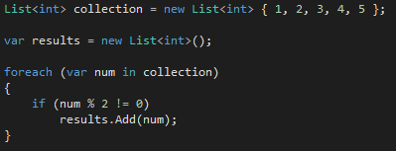

Functional vs. imperative
Imperative
Basic constructs are imperative statements
Changes existing values – changing the “state” of the application
i.e. define sequence of steps to be taken to achieve a goal
Functional
Basic constructs are declarative (declare new values)
Computation proceeds primarily by evaluating expressions

Slide 5
Referential transparency
A function that is referentially transparent returns values that depend only on the input parameters that are passed.
This is in contrast to the basic ideas of imperative programming, where program state often influences return values of functions.
Referential transparency means that the only responsibility of the programmer is the specification of functions to describe and solve a given set of problems.
On the basis of that specification, the computer can then decide on the best evaluation order, potential parallelization opportunities, or even whether a certain function needs to be evaluated at all.

Slide 6
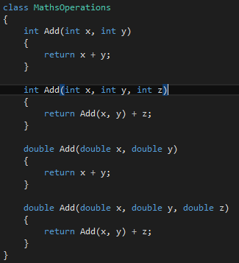
REUSING FUNCTIONS
Reuse is the greatest overall problem in computer programming.
After a very short time, small and large blocks of functionality start recurring, and programmers start trying to find ways to avoid wasting time by re-implementing code that’s already been written.
Simple example of an overloaded method

Slide 7
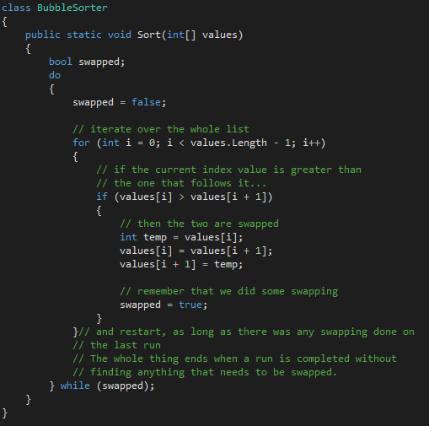
REUSING FUNCTIONS
Algorithms, reusability can be quite a bit more complex.
Example.
Specific to the type it is written for: the comparison of the two values.
The whole algorithm could be written to work with any type of data.

Slide 8
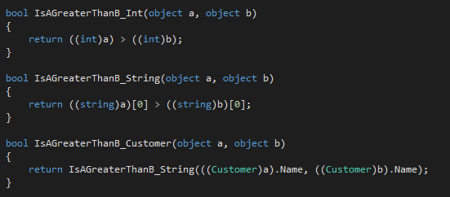
REUSING FUNCTIONS
Solution 1 - Changing implementation to use object (which is the base class of everything in .NET)
Problem – Lose type information
Operations on int – add, output, compare
Operations on object – don’t know which operations those objects support and how they should be performed
Solution 2 – Write multiple functions that take objects as parameters and then perform comparison operations on the data
Problem remains – specify which function to use
Depends on data in array – known only when function is called
Again – solution ?

Slide 9
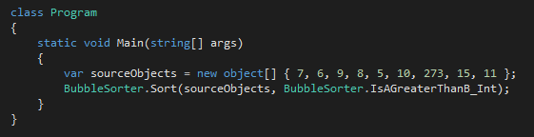
Delegates
Why not simply pass in the correct comparison function together with the data(array) ?
Example
Sort function was changed to accept a second parameter – the function
What does it look like now ?

Slide 10
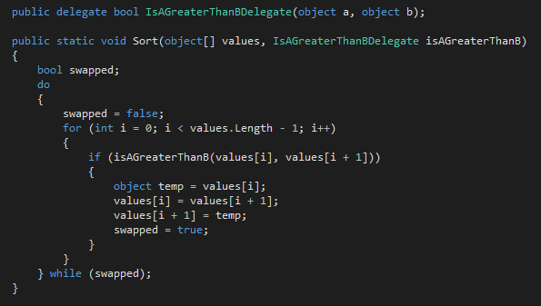
Delegates

Slide 11
Delegates
The public delegate is NOT part of the function itself – it can exist anywhere.
A delegate is a reference type that can be used to encapsulate a named or an anonymous method. Delegates are similar to function pointers in C++; however, delegates are type-safe and secure.
A delegate is a type that represents references to methods with a particular parameter list and return type – two parameters of type object and a bool return type in our case.
They are also referred to as function types.

Slide 12
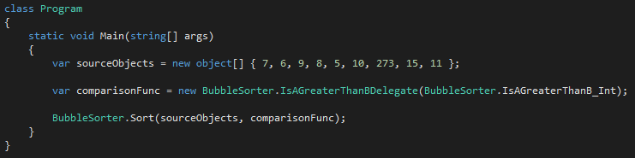
Delegates
Instantiating a delegate
When you instantiate a delegate, you can associate its instance with any method with a compatible signature and return type. You can invoke (or call) the method through the delegate instance.
Example – another way of doing it

Slide 13

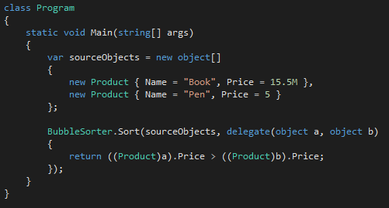
Anonymous functions
A new type was introduced into the system
Write a new function to compare ?
For each new type write a new function ?
Solution – Anonymous functions
C# 2.0 syntax
The anonymous method used here is fully compatible with the
delegate type

Slide 14
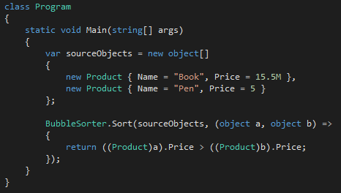

Anonymous functions – lambda expressions
The same anonymous function can be written like the following, using C# 3.0 lambda expression syntax
Change – removed delegate keyword and added => instead
Further shortening – drop the types of the parameters
Types can be inferred by the compiler from the declaration
of the delegate type

Slide 15
lambda expressions
Because the function doesn’t do anything but return a value, you can convert the body of the function into an expression body and benefit from an implicit return
Expression bodies – allow for a concise implementation of a particular behavior that functional programming asks for in a function: accept parameters, then return a value.
Further improvement ?

Slide 16
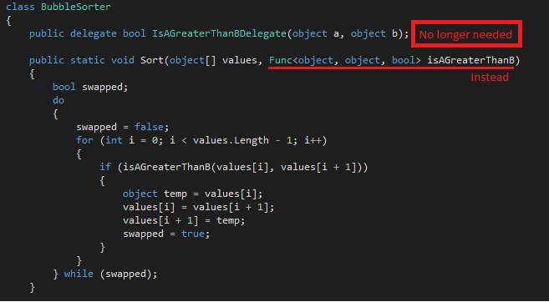
lambda expressions
In .NET 3.5, several new standard delegate types were added to the framework, meaning it’s no longer necessary to create custom delegates every time a function is used that has an as yet unknown signature, that is, one that hasn’t had a delegate created so far.
These delegate types are generic
Example
This delegate takes two object type parameters
and returns a bool.

Slide 17
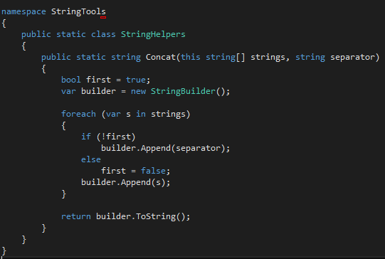
EXTENSION METHODS
Extension methods are static methods in static classes that are marked up specially.
Keyword this in front of the parameter strings is
specific to C#.
It instructs the compiler to add the
ExtensionMethodAttribute to the method.
Example
Notice this keyword
Notice the namespace

Slide 18
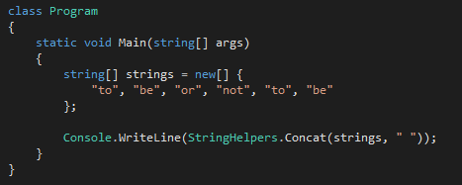
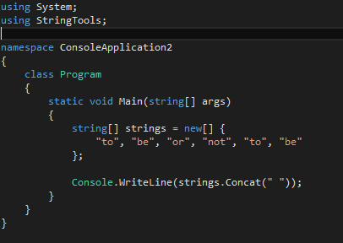
EXTENSION METHODS
How to use it
Called like any other static method
Called like an extension method ☺
Make sure to be using the extensions method’s class namespace
Otherwise the method will not be found – compiler error

Slide 19
LINQ
Language-Integrated Query (LINQ) is a set of features introduced in Visual Studio 2008 that extends powerful query capabilities to the language syntax of C# and Visual Basic.
LINQ introduces standard, easily-learned patterns for querying and updating data, and the technology can be extended to support potentially any kind of data store.
Visual Studio includes LINQ provider assemblies that enable the use of LINQ with .NET Framework collections, SQL Server databases, ADO.NET Datasets, and XML documents.
Two types: Fluent - Query

Slide 20
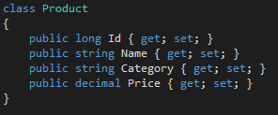



LINQ – Fluent vs. Query
Suppose we have a list of products
We have to select only products with price greater or equal to 15, ordered by the Id and the result should be formatted like: Category_Name
Fluent (sometimes called: Lambda Syntax)
Query

Slide 21
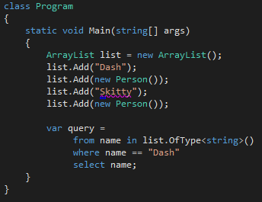
LINQ - Filtering operators
Where
Usually translates to WHERE clause when working with a relational database
OfType<T>
The only operator that can be applied to the non-generic list (does not implement IEnumerable<T>
Useful when working with an inheritance hierarchy and only want to select objects of a specific subtype from a collection

Slide 22
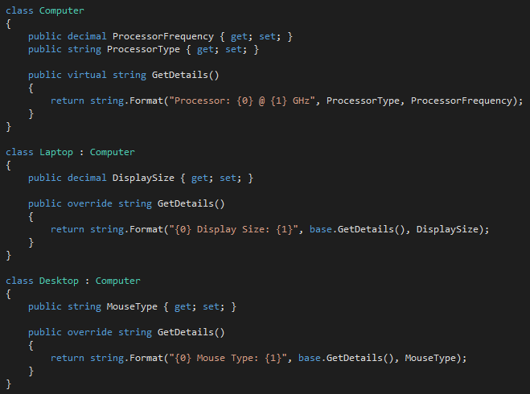
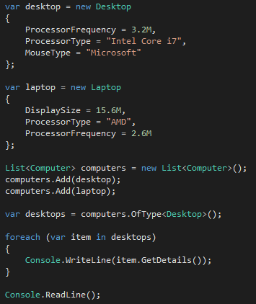
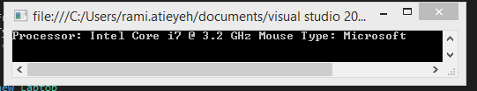
LINQ - Filtering operators
OfType<T> - Example

Slide 23
LINQ – projection operators
Select
Returns one output element for each input element
Can project a new type of element
SelectMany
For working with a sequence of sequences
Flattens the sub-sequence into a single output sequence
Example

Slide 24
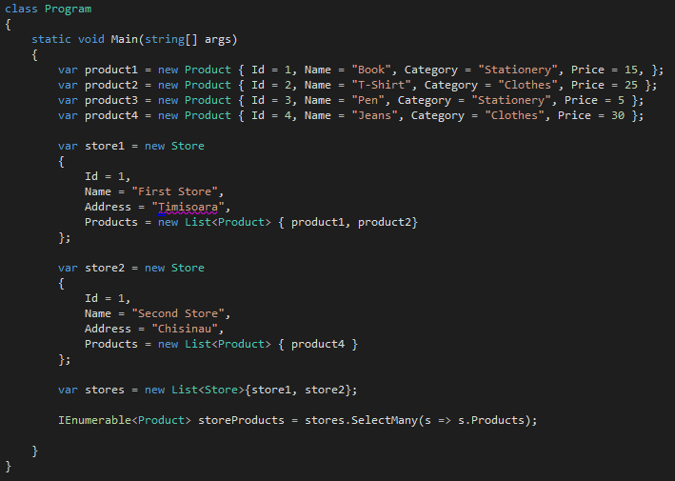
LINQ – projection operators

Slide 25
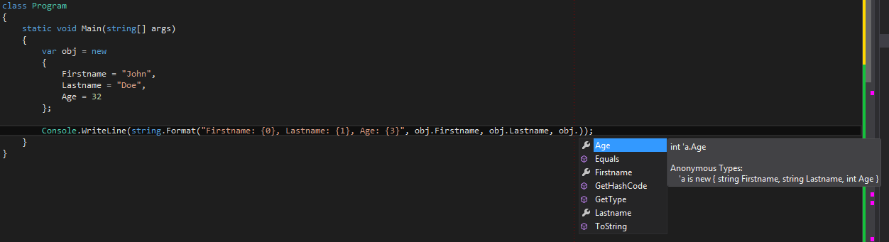
Anonymous types
Anonymous types provide a convenient way to encapsulate a set of read-only properties into a single object without having to explicitly define a type first.
The type name is generated by the compiler and is not available at the source code level. The type of each property is inferred by the compiler.
You create anonymous types by using the new operator together with an object initializer.
IntelliSense

Slide 26
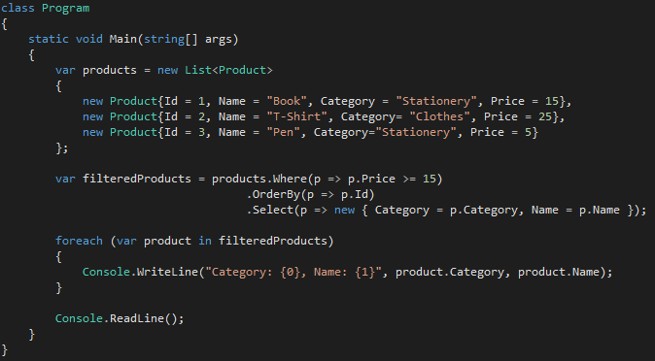
Anonymous types
Anonymous types contain one or more public read-only properties.
No other kinds of class members, such as methods or events, are valid.
The expression that is used to initialize a property cannot be null, an anonymous function, or a pointer type.
Anonymous types are class types that derive directly from object, and that cannot be cast to any type except object.
Widely used in LINQ Select operator.

Slide 27
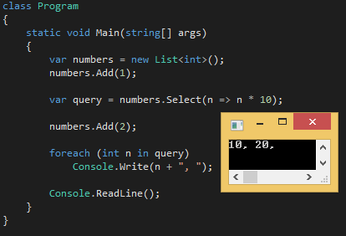
Deferred execution
An important feature of most query operators is that they execute not when constructed, but when enumerated.
The extra number that we sneaked into the list after constructing the query is included in the result, because it’s not until the foreach statement runs that any filtering or sorting takes place.
All standard query operators provide deferred execution, with the following exceptions:
Operators that return a single element or scalar value, such as First or Count
The following conversion operators: ToArray, ToList, ToDictionary, ToLookup

Slide 28
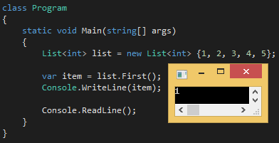
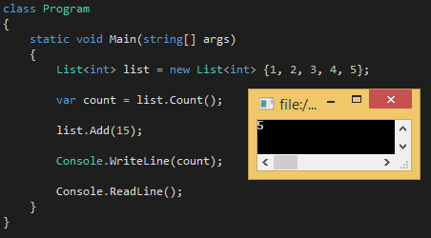
Deferred execution
First
Count

Slide 29
Assignment
Create a collection
Manipulate collection via delegates
Rewrite using anonymous functions
Rewrite using lambda expressions
Using extension methods on the collection
Using Select/where operators on the collection

Slide 30
references
Strum, Oliver (2011) Functional Programming in C#
MSDN– LINQ
MSDN – Anonymous Types
MSDN – Deferred Execution

